Slide 1
Digital Computer Design
General Purpose Microprocessors 2

Slide 2
EC-2 Instruction Set
Notations:
A = accumulator.
M = memory.
PC = program counter.
aaaaa = four bits for specifying a memory address.
× = don’t cares.

Slide 3
Datapath for EC-2

Slide 4
EC-2 CU: State Diagram

Slide 5
EC-2 CU: NS/Implementation Table

Slide 6
EC-2 CU: Excitation Equations

Slide 7
EC-2 CU: CW/Output Table

Slide 8
EC-2 CU: Output Equations

Slide 10
Complete Circuit for EC-2

Slide 11
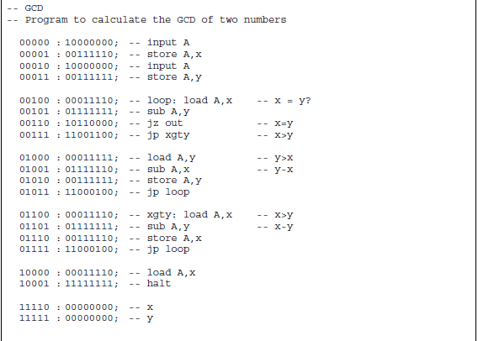
Sample Program 1

Slide 12
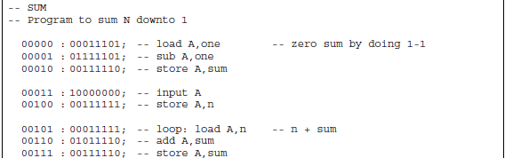
Sample Program 2 (1)

Slide 13
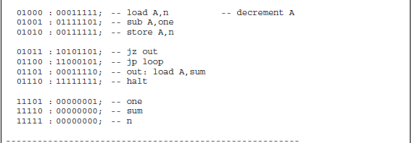
Sample Program 2 (2)

Slide 14
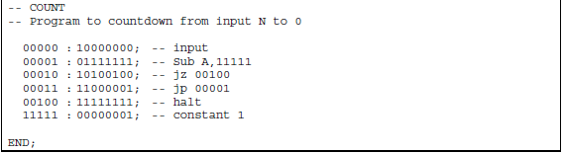
Sample Program 3

Slide 15
EC-2 Computer

